Slide 1
Secure Communication with Python: Make New Encryption and Decryption Technique
THIRUPPATHI D-(B.E)
CSE-RL/III YEAR

Slide 2

An overview of encryption and decryption methods to secure sensitive data. Understanding the importance of data protection and privacy in today digital world.

Slide 3


Symmetric Encryption
Understanding the principles of symmetric encryption, where the same key is used for both and decryption. Exploring popular symmetric encryption algorithms such as AES and DES.

Slide 4


Asymmetric Encryption
Exploring the concept of asymmetric encryption, which uses a pair of keys (public and private) for and decryption. Discussing the applications of asymmetric encryption in secure communication.

Slide 5



, including algorithms, keys, in safeguarding data from
Exploring the fundamental concepts of and ciphers. Understanding the role of unauthorized access.

Slide 6
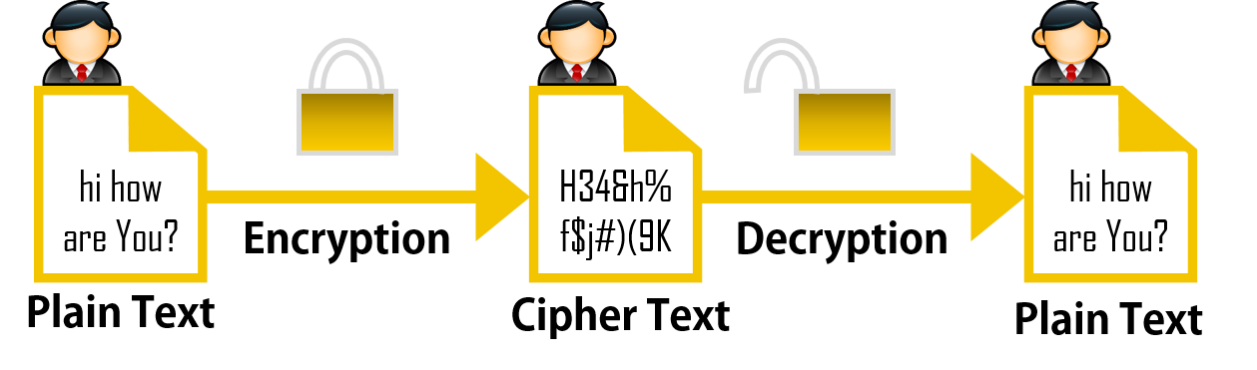
WORK FLOW OF MESSAGE TRANSACTION

Slide 7
My encryption Technique Workflow
WORD : HELLO
SECRETE KEY : 15
Word : H E L L O
ASCII VALUE : 72 69 76 76 79
+ + + + +
SECREATE KEY : 15 15 15 15 15
CIPHER TEXT VALUE : 87 84 91 91 94
CIPHER TEXT : W T [ [ ^

Slide 8
CIPHER TEXT : WT[[^
II-ENCRYPTION
PROGRAM GENERATE KEY : LENGTH OF WORD: 5
KEY OF 5 : N=N*2 :N=10
: N=N+2 :N=12
: N=N*5 :N=60
: N=N+5 :N=65
65(N) VALUE TO GET NEAREST PRIME NUMBER 67

Slide 9
CIPHER TEXT : W T [ [ ^
CIPHER TEXT VALUE : 87 84 91 91 94
+ + + + +
PROGRAM GEN KEY : 67 67 67 67 67
II CIPHER TEXT VALUE: 154 151 158 158 161
II CIPHER TEXT : !

Slide 10

SENDER SEND MESSAGE : !
RECEIVER DECRYPT TO GET MESSAGE: HELLO
WITH USING SAME SECREATE KEY AND ALGORITHM

Slide 11
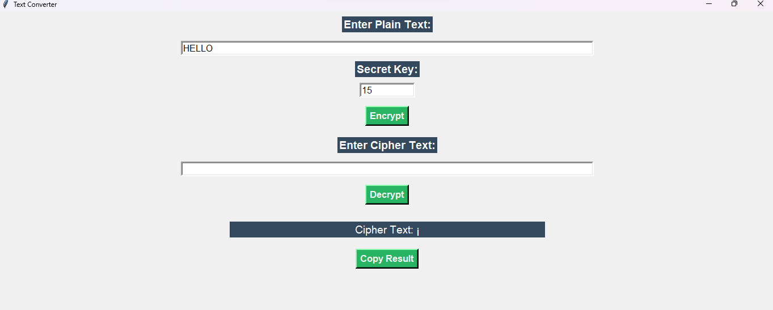
ENCRYPTION OUTPUT

Slide 12

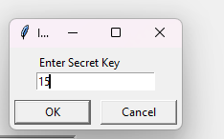
DECRYPTION OUTPUT

Slide 13
Thanks!
Do you have any questions?

